Slide 1

Ai Based Network Intrusion Detection System
Rahul K
APPLY_176295067869147e1643611

Slide 2

PROBLEM STATEMENT
With the rapid growth of digital infrastructure and network-based services, organizations face increasing threats from cyberattacks such as Distributed Denial of Service (DDo5), unauthorized access, and malicious network traffic. Traditional rule-based intrusion detection systems struggle to detect evolving attack patterns, generate high false positives, and lack adaptability to new threats.

Slide 3
Project Description
The Al-Based Network Intrusion Detection System (NIDS) is a machine-learning-powered security application designed to detect suspicious and malicious network behavior in real time.
Key Highlights: Uses Machine Learning (Random Forest Classifier) to classify network traffic as normal or attack. Supports simulation mode for academic demonstrations using synthetic data. Can be extended to real-world datasets such as the CIC-IDS2017 benchmark dataset

Slide 4

WHO ARE THE END USERS?
Students (CSE, IT, Cyber security)
Interns learning Machine learning and network security Faculties
AI/ML Trainers
Cybersecurity analysts
Network administrator
Researchers(Indirect users)
IT Security Teams

Slide 5

Technology Used
  Python
  Huggingface
  Pandas
  Numpy
  Grok

Slide 6
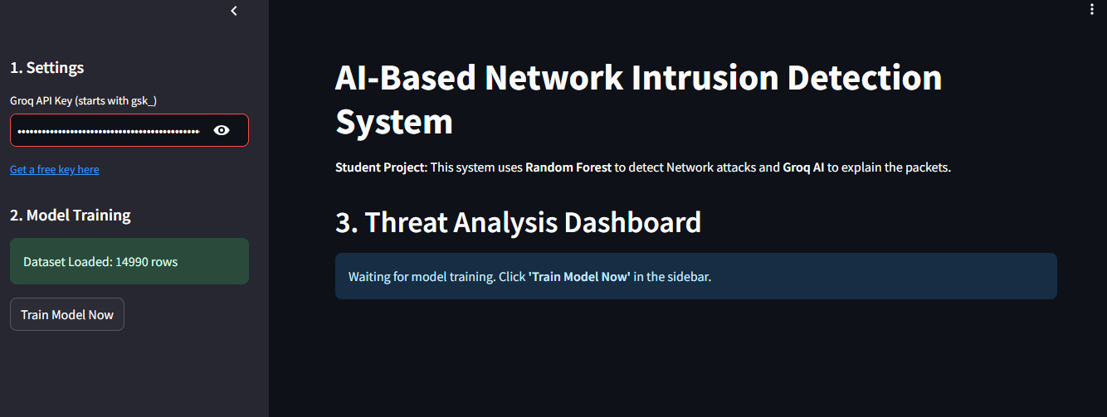
RESULTS
Demo Link

Slide 7
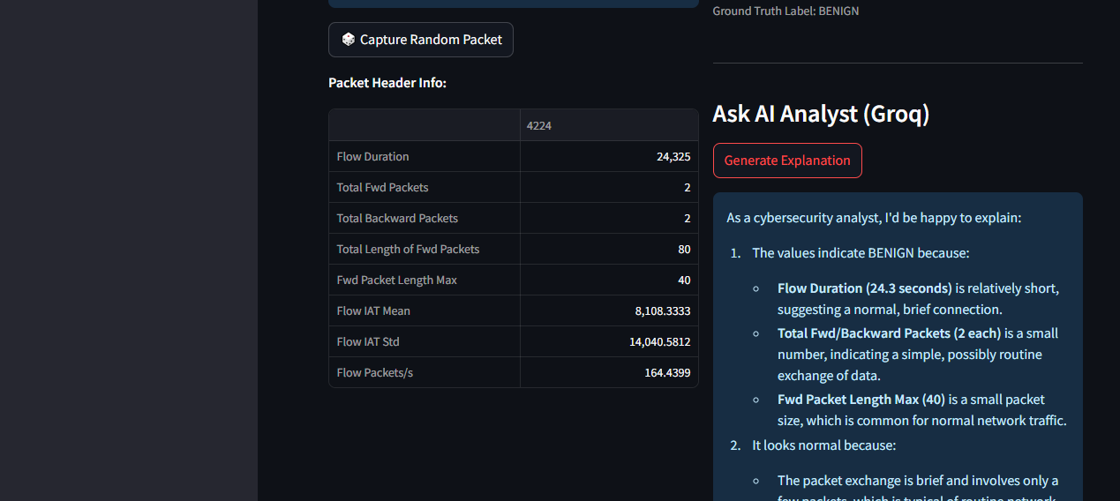
RESULTS
Demo Link

Slide 8

Certificate - Protection from browser attacks

Slide 9

Certificate - Introduction to System Security

Slide 10

Certificate - Securing Android Devices

Slide 11
GitHub link

Slide 12
Thank you
.
.

